Slide 1
Class Relationships Session 6
Course : COMP 6175
Object Oriented Programming
Effective Period : October 2018

Slide 2
Outline
Association
Aggregation
Composition

Slide 3
Class Relationships
To design classes, you need to explore the relationships among classes. The common relationships among classes are association, aggregation, composition

Slide 4

Association
Association is a general binary relationship that describes an activity between two classes. An association is illustrated by a solid line between two classes with an optional label that describes the relationship.
For example, a student taking a course is an association between the Student class and the Course class, and a faculty member teaching a course is an association between the Faculty class and the Course class.

Slide 5
Association (Cont.)
Each class involved in an association may specify a multiplicity. Some typical examples of multiplicity:
Multiplicity | Cardinality
0..0 | Collection must be empty
0..1 | No instances or one instance
1..1 | Exactly one instance
0..* | Zero or more instances
1..* | At least one instance
5..5 | Exactly 5 instances
m..n | At least m but no more than n instances

Slide 6
Association (Cont.)
Each student may take any number of courses, and each course must have at least five and at most sixty students. Each course is taught by only one faculty member, and a faculty member may teach from zero to three courses per semester

Slide 7
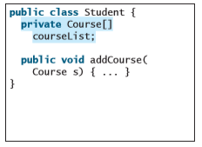
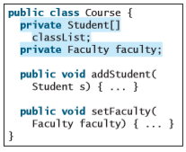
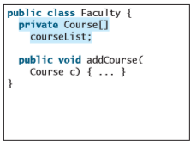
Association (Cont.)
In Java code, you can implement associations by using data fields and methods.
The association relations are implemented using data fields and methods in classes.

Slide 8
Aggregation and Composition
Aggregation is a special form of association that represents an ownership relationship between two objects. An object can be owned by several other aggregating objects.
If an object is exclusively owned by an aggregating object, the relationship between the object and its aggregating object is referred to as a composition.

Slide 9
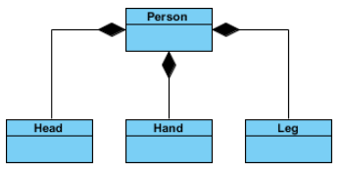
Aggregation and Composition
Composition implies a relationship where the child cannot exist (Head, Hand, Leg) independent of the parent (Person).

Slide 10
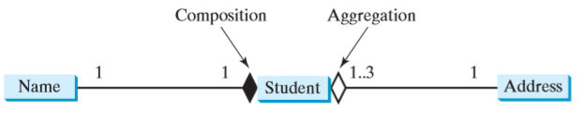
Aggregation and Composition
For example:
“a student has a name” is a composition relationship between the Student class and the Name class,
“a student has an address” is an aggregation relationship between the Student class and the Address class, since an address can be shared by several students.

Slide 11
Aggregation and Composition
Each student has only one multiplicity address
Each address can be shared by up to 3 students
Each student has one name, and a name is unique for each student.

Slide 12
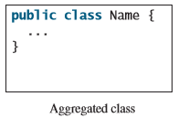
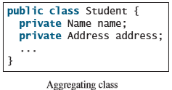
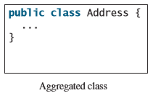
Aggregation and Composition
An aggregation relationship is usually represented as a data field in the aggregating class.

Slide 13
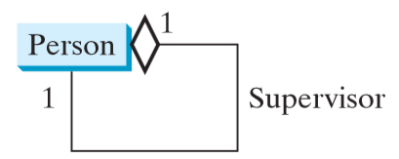
Aggregation and Composition
Aggregation may exist between objects of the same class. For example, a person may have a supervisor.

Slide 14
Association vs Aggregation / Composition
Consider the differences and similarities between the classes of the following objects: pets, cats, tails, owners.
owners feed pets, pets please owners (association)
a tail is a part of both dogs and cats (aggregation / composition

Slide 15
References
Daniel Liang, Y., 2015, Introduction to java programming, vol.10, Pearson Education, New Jersey.
UML Association vs Aggregation vs Composition. https://www.visual-paradigm.com/guide/uml-unified-modeling-language/uml-aggregation-vs-composition/

